Slide 1
Module 9 Part 1 Management and Governance
Harvinder S Jabbal
SSZG653 Software Architectures

Slide 2
Management and Governance

Slide 3
Outline
Planning
Organizing
Implementing
Measuring
Governance
Summary

Slide 4
Planning
The planning for a project proceeds over time.
There is an initial plan that is necessarily top-down to convince upper management to build this system and give them some idea of the cost and schedule.
This top-down schedule is inherently going to be incorrect, possibly by large amounts.
Once the system has been given a go-ahead and a budget, the architecture team is formed and produces an initial architecture design.

Slide 5
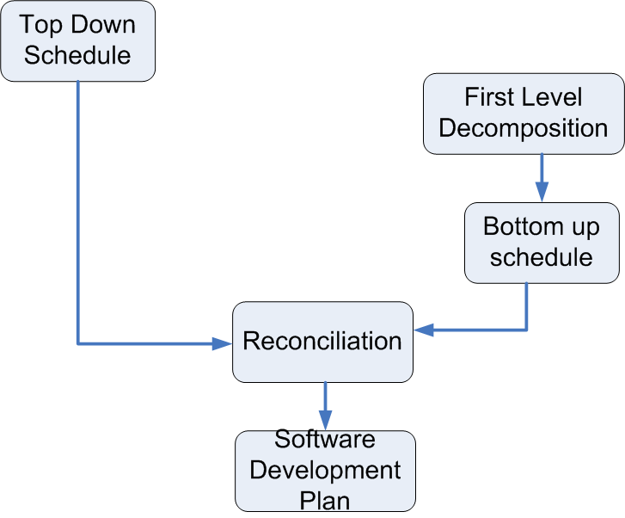
The Planning Process

Slide 6
Top Down Schedule
A top down schedule is needed to enable management to decide whether to do the project and to allocate resources.
Example: For a medium size project (~150K SLOC)
Number of components to be estimated: ~150
Paper design time per component: ~4 hours
Time between engineering releases: ~8 weeks
Overall project development allocation:
40 percent design: 5 percent architectural, 35 percent detailed
20 percent coding
40 percent testing

Slide 7
Remaining Planning Steps
An architecture team is created and they develop the first level decomposition of the architecture.
Each member of the architecture team will be the lead architect for each major subsystem.
A bottom up schedule is created by the architecture team
Typically more accurate than the top down schedule
The top down and the bottom up schedules must be reconciled to produce final (initial) schedule.
Software development plan is written that specifies releases dates and features per release. This plan guides the initial activities of the project.

Slide 8
Organizing
Division of responsibilities between project manager and software architect
Global Software Development

Slide 9
Project Manager and Software Architect
This is the most important working relationship on the team.
The people in each role—PM and SA—must
Respect each other
Coordinate
Stick to their respective spheres.

Slide 10
Project Management Body of Knowledge (PMBOK)
Published by the Project Management Institute
ANSI and IEEE standard
Process groups
The five process groups are:
Initiating.
Planning.
Executing.
Monitoring and Controlling.
Closing.

Slide 11
Initiating:
processes performed to define a new project or a new phase of an existing project
obtaining authorization to start the project or phase.

Slide 12
Planning:
Those processes required to establish the scope of the project, refine the objectives, and define the course of action required to attain the objectives that the project was undertaken to achieve.

Slide 13
Executing:
Those processes performed to complete the work defined in the project management plan to satisfy the project specifications

Slide 14
Monitoring and Controlling:
Those processes required to track, review, and regulate the progress and performance of the project;
Identify any areas in which changes to the plan are required; and initiate the corresponding changes.

Slide 15
Closing:
Those processes performed to finalize all activities across all Process Groups to formally close the project or phase.

Slide 16
Project Management Body of Knowledge (PMBOK)
Published by the Project Management Institute
ANSI and IEEE standard
Ten project management knowledge areas
Project Integration Management.
Project Scope management.
Project Schedule Management.
Project Cost Management.
Project Quality Management.
Project Resource Management.
Project Communications Management.
Project Risk Management.
Project Procurement Management.
Project Stakeholder Engagement.

Slide 17
Integration Management
Ensuring that the various elements of the project are properly coordinated. The processes and activities needed to identify, define, combine, unify, and coordinate the various processes and project management activities within the project management process groups.
Developing, overseeing, and updating the project plan. Managing change control process.
PM: Organizes project, manages resources, budgets and schedules. Defines metrics and metric collection strategy. Oversees change control process.
SA: Creates design and organizes team around design. Manages dependencies. Implements the capture of the metrics. Orchestrates requests for changes. Ensures that appropriate IT infrastructure exists.

Slide 18
Scope Management
Ensuring that the project includes all of the work required and only the work required.
Requirements
PM: Negotiates project scope with marketing and software architect.
SA: Elicits, negotiates, and reviews run time requirements and generate development requirements. Estimates cost, schedule, and risk of meeting requirements.

Slide 19
Schedule Management
Ensuring that the project completes in a timely fashion.(Time Management in PMBOK6)
Work breakdown structure and completion tracking. Project network diagram with dates.
PM: Oversees progress against schedule. Helps define work breakdown structure. Schedule coarse activities to meet deadlines.
SA: Helps define work breakdown structure. Defines tracking measures. Recommends assignment of resources to software development teams.

Slide 20
Cost Management
Ensuring that the project is completed within the approved budget.
Planning, estimating, budgeting, financing, funding, managing, and controlling costs.
PM: Calculates cost to completion at various stages, makes decisions regarding build/buy and allocation of resources.
SA: Gathers costs from individual teams, makes recommendations regarding build/buy and resource allocations.

Slide 21
Quality Management
Determine quality policies, objectives, and responsibilities ensuring that the project will satisfy the needs for which it was undertaken.
Quality & Metrics
PM: Defines productivity, size, and project-level quality measures.
SA: Designs for quality and tracks system against design. Defines code-level quality metrics.

Slide 22
Resource Management
Organise, manage and lead ensuring that the project makes the most effective use of the people involved with the project.(Human Resource Management in PMBOK6)
Managing people and their careers
PM: Maps skill sets of people against required skill sets. Ensures that appropriate training is provided. Monitors and mentors career paths of individuals. Authorizes recruitment.
SA: Defines required technical skill sets. Mentors developers about career paths. Recommends training. Interviews candidates.

Slide 23
Communications Management
Ensuring timely and appropriate planning, collection, creation, distribution, storage, retrieval, management, control, monitoring, and the ultimate disposition of project information.
Communicating
PM: Manages communication between team and external entities. Reports to upper management.
SA: Ensures communication and coordination among developers. Solicits feedback as to progress, problems, and risks.

Slide 24
Risk Management
conducting risk management planning, identification, analysis, response planning, and controlling risk on a project.
Risk Management
PM: Prioritizes risks, reports risks to management, takes steps to mitigate risks.
SA: Identifies and quantifies risks, adjusts architecture and processes to mitigate risk.

Slide 25
Procurement Management
Purchase or acquire products, services, or results needed from outside the project team. Processes in this area include Procurement Planning, Solicitation Planning, Solicitation, Source Selection, Contract Administration, and Contract Closeout.
Technology
PM: Procures necessary resources. Introduces new technology.
SA: Determines technology requirements. Recommends technology, training, and tools.

Slide 26
Project Stakeholder Engagement
The processes required to identify all people or organizations impacted by the project, analyzing stakeholder expectations and impact on the project, and developing appropriate management strategies for effectively engaging stakeholders in project decisions and execution.
PM- Assess key participants and how the project affects their problems and needs.
SA- Ensure the stakeholders’ needs and concerns are dealt with appropriately.

Slide 27
Processes/Activities – Knowledge Areas.
Each of the ten knowledge areas contains the processes that need to be accomplished within its discipline in order to achieve effective project management.
Each of these processes also falls into one of the five process groups, creating a matrix structure such that every process can be related to one knowledge area and one process group.

Slide 28
Global Software Development
A very common development context.
Driven by
(Labor) costs
Skill sets and labor availability.
Local knowledge of markets.
Global development means that coordination among teams is critical.

Slide 29
Team Coordination Induced by Module Interaction
If there is a dependency between two modules, the teams assigned to those modules must coordinate over the shared interfaces.
Team A
Team B
Coordination
Module A
Module B
Dependency

Slide 30
Coordination
Local coordination can be informal and spontaneous.
Remote coordination must be more structured.
Coordination mechanisms:
Documentation
Meetings
Electronic media

Slide 31
Implementation Issues
Trade-offs
Incremental development
Tracking progress

Slide 32
Trade-offs
Software architect makes trade-offs among various quality attributes.
Project manager makes trade-offs among
Features
Schedule
Quality
Project manager should resist creeping functionality (scope creep)
Affects schedule
Can use a Change Control Board to manage (typically slow down) the pace of changes

Slide 33
Incremental Development
A release may be in one of three states
Planning
Development
Test and repair
All three states can be simultaneously active for different releases.

Slide 34
Tracking Progress
Progress can be tracked through
Personal contact (doesn’t scale)
Meetings
Metrics
Risk management
Meetings
Expensive use of time
Either status or working – do not intermix
One output of status meetings should be risks
Risks have
Cost if they occur
Likelihood of their occurrence
Project manager prioritizes risks

Slide 35
Measuring
Metrics are an important tool for project managers. They enable the manager to have an objective basis both for their own decision making and for reporting to upper management on the progress of the project.
Metrics can be global—pertaining to the whole project—or they may depend on a particular phase of the project.

Slide 36
Global Metrics
Global metrics aid the project manager in obtaining an overall sense of the project and tracking its progress over time.
Some example metrics, that any project should capture:
Size
Schedule deviation
Developer productivity
Defects
Metrics should be tracked both historically for the organization and for the specific project.

Slide 37
Phase Metrics and Cost to Complete
Phase metrics
Open issues
Unmitigated risks
Cost to complete
Bottom-up metric
Responsibility of lead architect for each subsystem team

Slide 38
Governance
Four responsibilities of a governing board
Implementing a system of controls over the creation and monitoring of all architectural components and activities, to ensure the effective introduction, implementation, and evolution of architectures within the organization.
Implementing a system to ensure compliance with internal and external standards and regulatory obligations.
Establishing processes that support effective management of the above processes within agreed parameters.
Developing practices that ensure accountability to a clearly identified stakeholder community, both inside and outside the organization.

Slide 39
Summary
A project must be planned, organized, implemented, tracked, and governed.
Top-down schedule based on size
Bottom-up schedule based on top level decomposition.
Reconciliation of two schedules is the basis for the software development plan.
Teams are created based on the software development plan.
The software architect and the project manage must coordinate to oversee the implementation.
Global development creates a need for an explicit coordination strategy.
Management trade offs are between schedule, function, and cost.
Progress must be tracked.
Larger systems require formal governance mechanisms.

